Slide 1
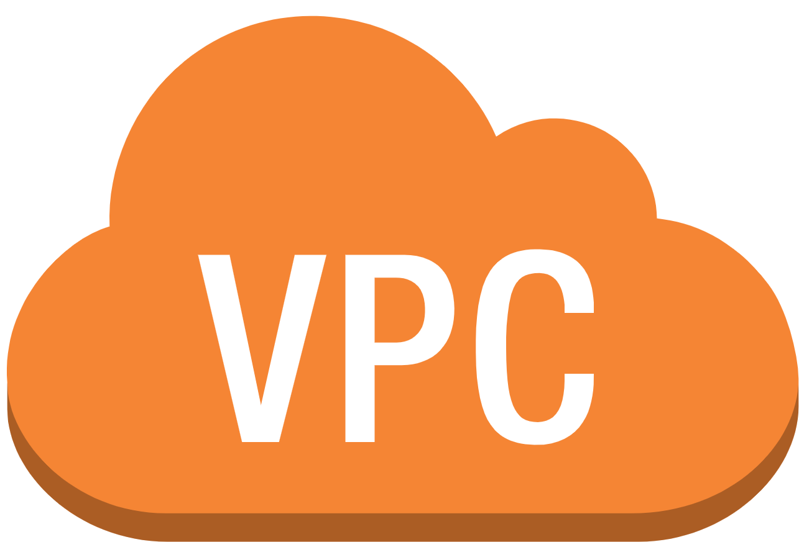
Virtual Private Cloud

Slide 2
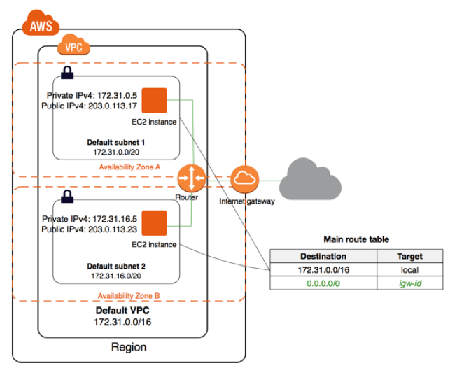
AWS VPC - Service Introduction
Amazon Virtual Private Cloud (Amazon VPC) enables you to launch AWS resources into a virtual network that you've defined.
Virtual Private Cloud (VPC) enables customers to build multiple isolated and secure networks within their AWS accounts, allowing them to isolate workloads and applications.

Slide 3
Default VPC Vs Custom VPC
Default VPC | Custom VPC
When you create a AWS account, it gets created by default. | It is created by you.
A default VPC comes with a public subnet in each Availability Zone, an internet gateway, and settings to enable DNS resolution. Therefore, you can immediately start launching Amazon EC2 instances into a default VPC | You have to explicitly create subnet,NAt gateways, Internet gateways,security groups etc

Slide 4
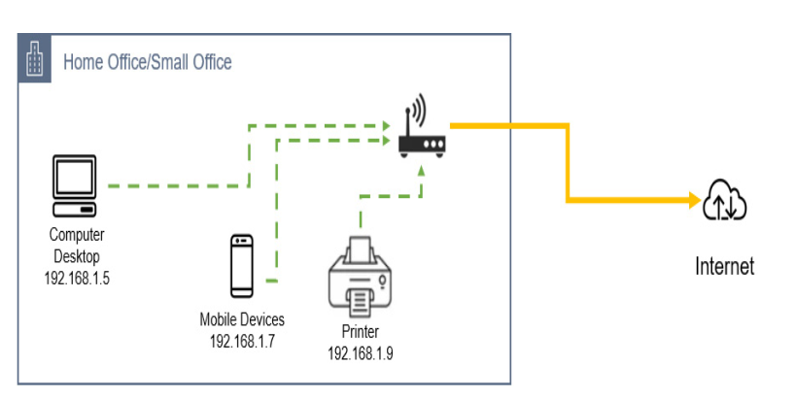
IP Address
An IP address, or Internet Protocol address, is a series of numbers that identifies any device on a network.
Computers use IP addresses to communicate with each other both over the internet as well as on other networks

Slide 5
Classless Interdomain Routing (CIDR)
It is a method of assigning Internet Protocol (IP) addresses that improves the efficiency of address distribution
This will help in determine how many IP addresses you can have in that network. When defining a network, CIDR blocks are displayed as part of the IP address block with a slash (/) followed by a decimal number between /8 and /32.

Slide 6
Examples
192.168.1.0/24
8
8
8
8
The total number of IP addresses we can have in that network=32-24
=8 2^8 equals 256
So, the total number of IP addresses in network 192.168.1.0/24 is 256 IP addresses.

Slide 7
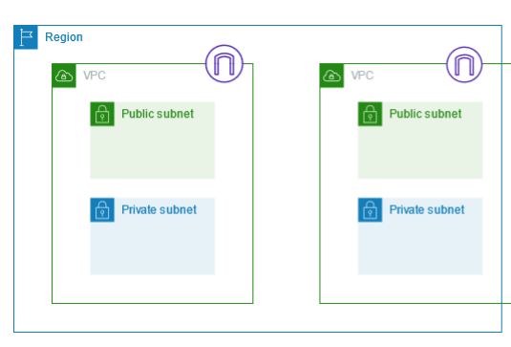
Subnets
A subnet is a subset of the VPC, and this is defined in the IP address block of the subnet.
A subnet is a range of IP addresses in your VPC
You can launch AWS resources into a specified subnet. Use a public subnet for resources that must be connected to the internet, and a private subnet for resources that won't be connected to the internet.

Slide 8
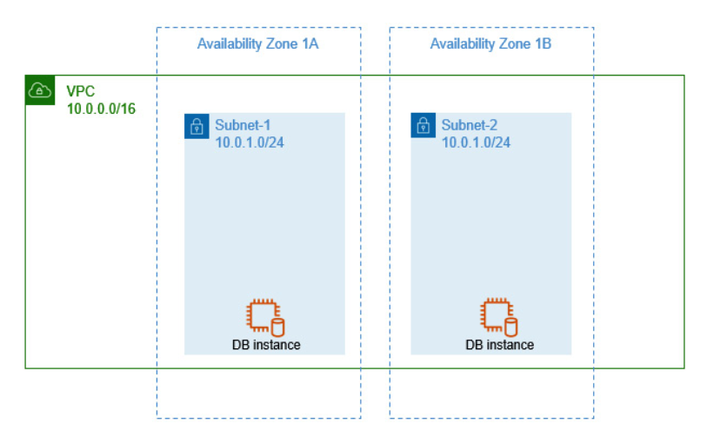
Subnets

Slide 9
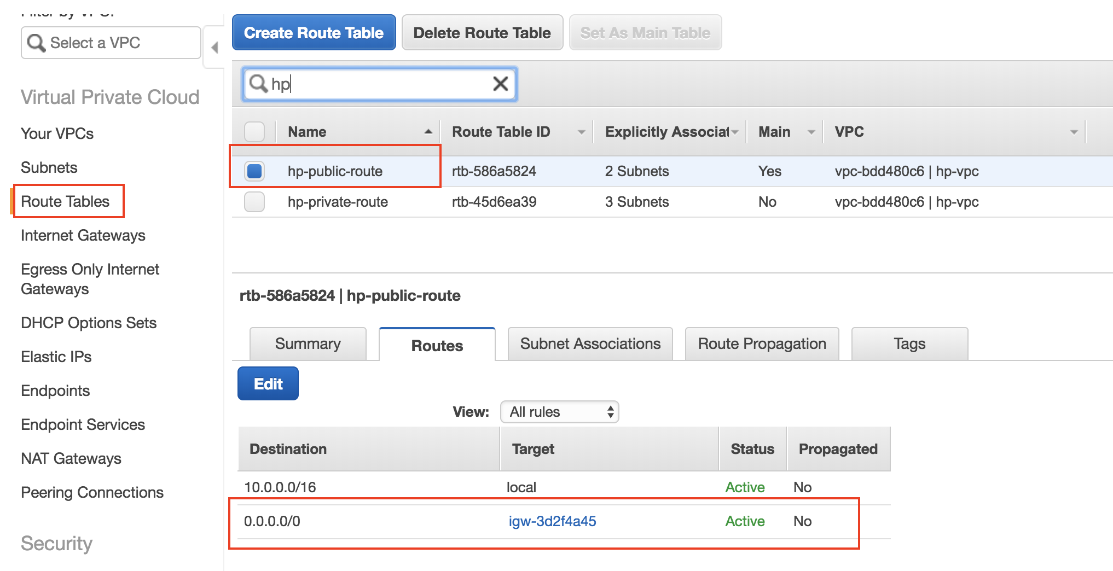
Routes Tables
A route table contains a set of rules, called routes, that determine where network traffic from your subnet or gateway is directed.

Slide 10
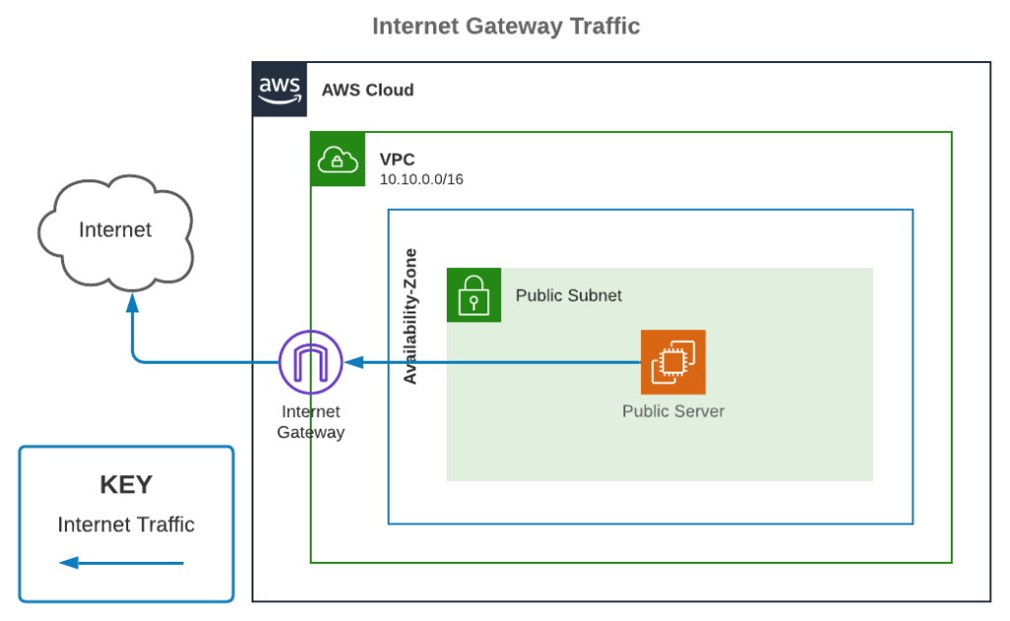
Internet gateways
An internet gateway is a horizontally scaled, redundant, and highly available VPC component that allows communication between your VPC and the internet

Slide 11
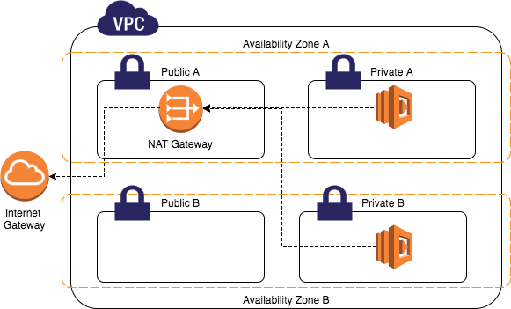
Nat gateways
A NAT gateway is a Network Address Translation (NAT) service. You can use a NAT gateway so that instances in a private subnet can connect to services outside your VPC but external services cannot initiate a connection with those instances.

Slide 12
Hands On

Slide 13
VPC - Summery
VPC: Virtual Private Cloud
• Subnets: Tied to an AZ, network partition of the VPC
• Internet Gateway: at the VPC level, provide Internet Access
• NAT Gateway / Instances: give internet access to private subnets
• NACL: Stateless, subnet rules for inbound and outbound
• Security Groups: Stateful, operate at the EC2 instance level or ENI
• VPC Peering: Connect two VPC with non overlapping IP ranges, nontransitive
• VPC Endpoints: Provide private access to AWS Services within VPC
• VPC Flow Logs: network traffic logs
• Site to Site VPN: VPN over public internet between on-premises DC and AWS
• Direct Connect: direct private connection to AWS
• Transit Gateway: Connect thousands of VPC and on-premises networks together

